Slide 1

Vlog #3
By The 4 Codesmen - Abraham, Dhruv, Dinesh, Favor
ENSE 400/477(2022-2023): SSE Capstone

Slide 2
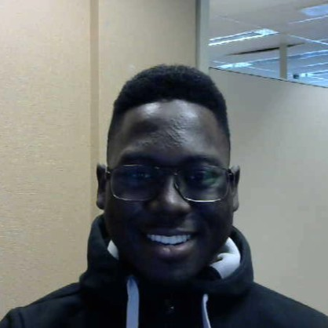
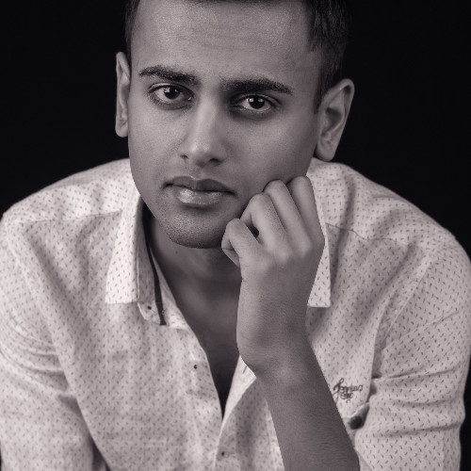
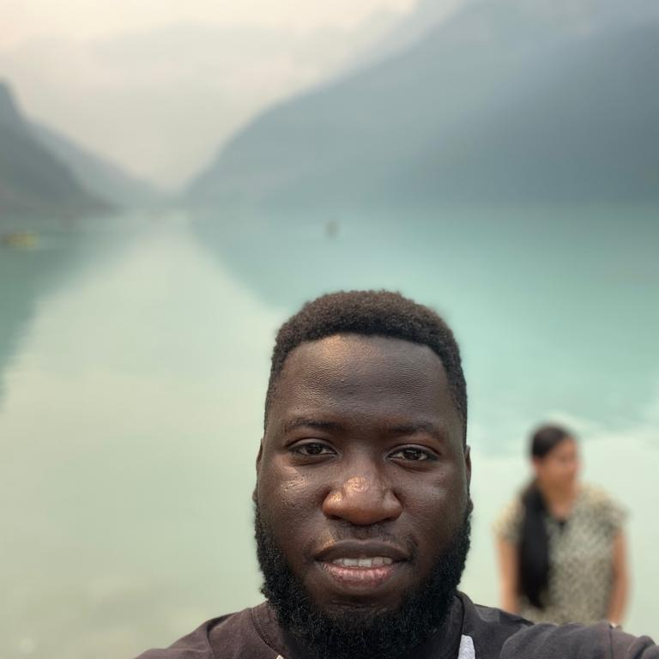
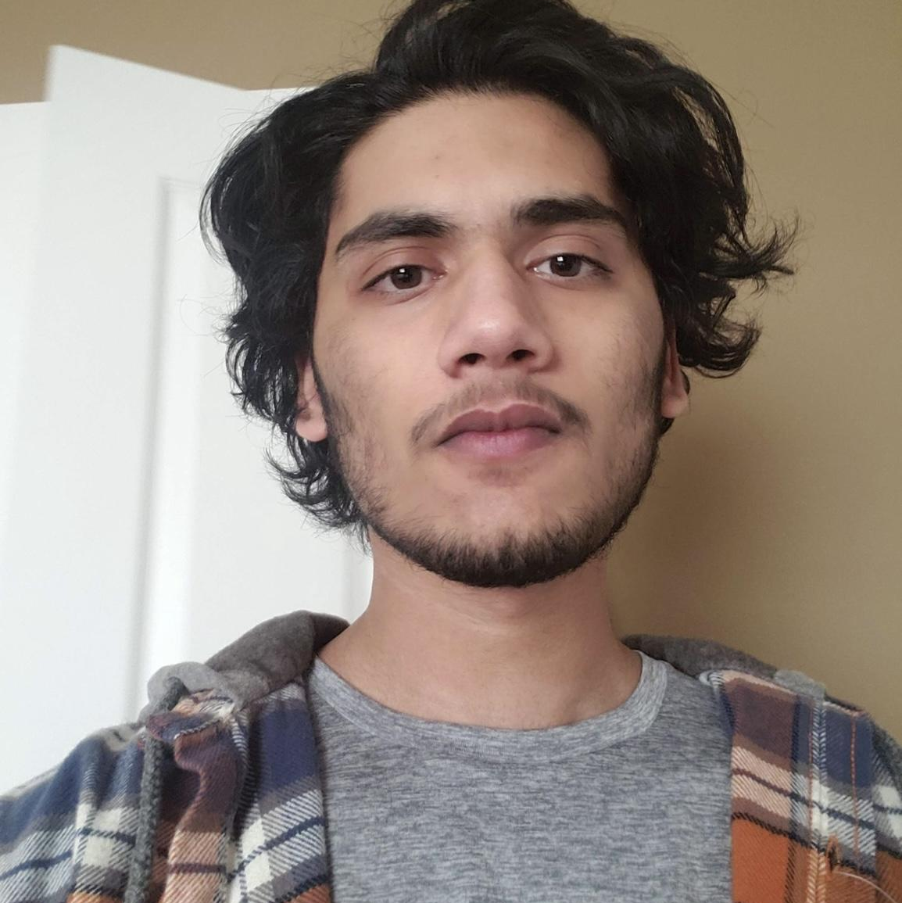
Team Presentation
Favor Fasunwon Front-End Developer and UI/UX Designer
Dhruv Modi Team Lead and Backend Developer
Abraham Mugerwa Front-End Developer and Documentation Manager
Dinesh Dalip Software Architect and Backend Developer

Slide 3
Project background & business need/opportunity
For our capstone project we are building a web application for U of R residence that allows U of R Residence Students:
To connect with each other
Make friends
Help each other out academically [Build a community]
Be part of the Residence life [Stay updated about events]
To decrease/eliminate the social gap [Less isolation and increased socialization]
Current Situation?
Opportunity?
Notes:
Current Situation
Currently U of R Residence does not have a dynamic application that brings U of R Students together. There is an application for U of R Residence however it is outdated and requires a major upgrade.
Opportunity
Build an application for U of R residence that
Replaces the old application
Enhances the experience of living on campus
Go beyond U of R and share this digital ecosystem with other University Residences as well.

Slide 4
Status Description
Green
We believe we are still in the Green zone as we have completed 2 out of the 4 anticipated features we had planned. More importantly we were able to appropriately utilize the MVC design pattern for each feature.
Responsibilities during previous 3 weeks
Team: Had a meeting with Craig (Mentor), assigned different features to each members via sub groups (2 sub groups - Dhruv and Abraham (Food Feature), Favor and Dinesh (chat system)), merged completed code for Food Feature and Chat Feature
Dhruv: Took the lead on creating the Takeouts Page with Favor on call for assistance. Emailed Craig for meeting, I and Favour refactored/restructured the Takeouts Page code .
Abraham: Took the lead on creating the recipe page with Dinesh on call for assistance, completed Meeting minutes. Worked with Favor to refactor styling of entire App to look more presentable and fit the aspired theme
Dinesh: Worked with Favor on Chat System, helped Abraham with Recipe feature, and Created Gantt chart.
Favor: Worked with Dinesh on Chat System. Implemented delete user functionality. Worked with Abraham to refactor styling of entire App to look more presentable and fit the aspired theme

Slide 5
Project Changes/Issues
Changes
Minor changes to Chat system
Users are now placed into their respective Faculty room rather than having access to all the rooms
Minor UI changes
Changes to Gantt Charts
Team finished all tasks before deadlines
Issues
Difficulties implementing new message notification system for easily identifying from who a user gets a new message.

Slide 6
Gantt Chart (adjusted)
Dec
Jan
Feb
March
W1
W2
W3
W4
W1
W2
W3
W4
W1
W2
W3
W4
W1
W2
W3
W4
Dashboard Feature
Community MVP2
Refactoring and documation
Event Feature
Events MVP2
Chat Feature modification
Food MVP2
Scope creep
Testing
Host
LOREM

Slide 7

Documentation overview and/or project demo

Slide 8
Next Up
Team:
Research Mern stack deployment (preferably Heroku – its free lol)
Record Vlog #3
Dhruv:
Will take the lead on the dashboard feature
Research more on PWA (Progressive web app)
Dinesh:
Will take the lead on the creating events page
Add functionalities to the Chat System (ability for users to create group chats, add notification system, and improve UI)
Abraham & Favor:
Will be on call for Dinesh and Dhruv as they complete the Dashboard and Events Page.
Update documentation as needed Github and Wiki (Abraham)

Slide 9
Retrospective
What went well?
Collaboration, WorkFlow and Research on the tech stack we used
What could be improved?
Commenting and overall implementing more readable code
Ensure there is no use of global variables (good Programming Practice)
What will the team commit to continue or change in ENSE 477?
We will commit to our Business opportunity and try to keep improving the application to make it more versatile, thus, endearing students in residence to utilize it as a tool to help make resident life easier.

Slide 10
Team Reflection
Does the team feel "on track"? (reiterate the above colour status)
We feel we’ve accomplished a lot in terms of our application’s functionality as we only have 2 features left to finish MVP 1
What progress does the team particularly feel good (great) about?
Collaboration, and workflow (dividing work based on sub groups of 2 members). Also the assistance of each member in face of road blocks.
What barriers (if any) does the team feel are a current impediment to success?
Complex features which makes our application more versatile, one being the ability to add notifications in the Chat System.
What help (if any) does the team require to move positively forward?
Technical help from our mentor, lab instructors and professors if possible
What questions or concerns does the team have (if any)?
N/A

Slide 11
Thanks!
Any questions?
You can reach our group at:
fourcodesmen@gmail.com

Slide 12
Credits
Special thanks to all the people who made and released these awesome resources for free:
Presentation template by SlidesCarnival
Photographs by Unsplash
Illustrations by Undraw.co

